Slide 1
Quantum Essentials
Divisible vs reducible Vs decomposable

Slide 2


Divisible
vs
Reducible
There exists a process where the final state consists of two or more independent systems (e.g. $𝒫_{t} :𝒮 →𝒮_{1}×𝒮_{2}$)
The state of the whole can be expressed as the state of the parts at the same time (e.g. $𝒮≡𝒮_{1}×𝒮_{2}$)
time
time

Slide 3
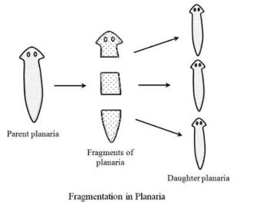
Planarian worm is DIVISIBLE into three planaria
You start with a worm, chop it up, and end with three worms
Describing one worm does not mean describing three worms
Planarian worm is NOT REDUCIBLE to three planaria

Slide 4
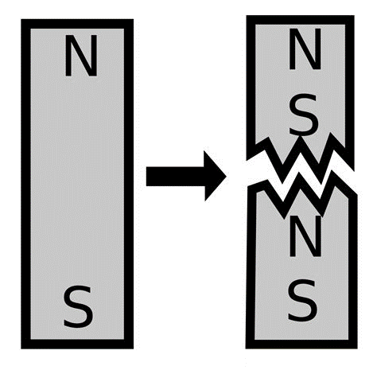
A magnet is NOT DIVISIBLE into N/S poles
Breaking up a magnet does not give you separate north and south poles
Describing a magnet means describing the north and the south pole
A magnet is REDUCIBLE to N/S poles

Slide 5
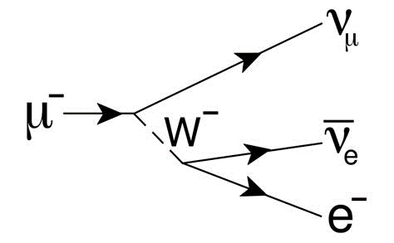
A muon is DIVISIBLE into three particles
Given enough time, a muon will decay into an electron, a neutrino and an anti-neutrino
Describing one muon does not mean describing three particles: the muon is a fundamental particle
A muon is NOT REDUCIBLE to three particles

Slide 6
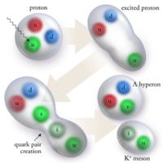
A proton is NOT DIVISIBLE into quarks
Because of QCD confinement, you cannot isolate quarks
Describing a proton means describing its quarks
A proton is REDUCIBLE to quarks

Slide 7
Quantum systems are irreducible, not indivisible!

Slide 8
Quantum systems are irreducible, not indivisible!
Quantum systems can absorb, radiate, decay, entangle, … All of these are forms of merging and splitting
Fundamental particles are objects that can’t be further described (as far as we know!) in terms of others (i.e. reduced)

Slide 9




Divisible
vs
Decomposable
We can calculate a property by combining independent contributions (e.g. $+ :𝒮×𝒮→𝒮$ and $F\left(𝓈_{1}+𝓈_{2}\right)=F\left(𝓈_{1}\right)+$ $F\left(𝓈_{2}\right)$)
Reducible
$$dλ$$
$$dy{ e}_{y}$$
$$dx{ e}_{x}$$

Slide 10




Work along an infinitesimal displacement is DECOMPOSABLE into vertical and horizontal contributions
Work is a linear functional: $F\left(dλ\right)=F_{x}dx+F_{y}dy$
$$dλ$$
$$dy{ e}_{y}$$
Length is NOT a linear functional: $$ℒ\left(dλ\right)≠ℒ(dxe_{x})+ℒ(dye_{y})$$
$$dx{ e}_{x}$$
Length along an infinitesimal displacement is NOT DECOMPOSABLE into vertical and horizontal contributions

Slide 11

Decomposability (i.e. linearity) is not a feature of just the object (e.g. displacement) or the property (e.g. work). It’s a feature of their relationship
$F\left(𝓈_{1}+𝓈_{2}\right)=F\left(𝓈_{1}\right)+$ $F\left(𝓈_{2}\right)$
$$dλ$$
$$dy{ e}_{y}$$
Infinitesimal displacements are neither DIVISIBLE nor REDUCIBLE to their vertical and horizontal components
$$dx{ e}_{x}$$

Slide 12


Superpositions in quantum mechanics are decompositions
Linearity of time evolution over superpositions: $$𝒯 \left|ψ_{1}+ψ_{2} \right\rangle =𝒯 \left|ψ_{1}\right\rangle +𝒯 \left|ψ_{2}\right\rangle$$
Also linearity of expectation over sum of observables
$$\left\langle ψ\left|X_{1}+X_{2}\right|ψ\right\rangle =\left\langle ψ\left|X_{1}\right|ψ\right\rangle +\left\langle ψ\left|X_{2}\right|ψ\right\rangle$$
However, no linearity of expectation over superposition:
$$\left\langle ψ_{1}+ψ_{2}\left|X\right|ψ_{1}+ψ_{2}\right\rangle ≠\left\langle ψ_{1}\left|X\right|ψ_{1}\right\rangle +\left\langle ψ_{2}\left|X\right|ψ_{2}\right\rangle$$

Slide 13


In classical statistics/probability expectation is linear:
$$∫x\left(aρ_{1}+bρ_{2}\right)dx=a∫xρ_{1}dx+b∫xρ_{2}dx$$
this makes decomposability equivalent to reducibility in classical mechanics
If $ψ_{1}$ and $ψ_{2}$ are eigenstates of $X$
$$\left\langle ψ_{1}+ψ_{2}\left|X\right|ψ_{1}+ψ_{2}\right\rangle =\left\langle ψ_{1}\left|X\right|ψ_{1}\right\rangle +\left\langle ψ_{2}\left|X\right|ψ_{2}\right\rangle$$
we recover classical probability but only for one property at a time
Superpositions do not combine parts, are not probability distributions

Slide 14
Divisible
Decomposable
$$dλ$$
$$dy{ e}_{y}$$
Reducible
$$dx{ e}_{x}$$

